Slide 1




BPM As A Cornerstone of Post-IT Enterprise.
Wolf Rivkin
Chief Enterprise Architect B-Wave Software LLC.
B-Wave Software ®.
All Rights Reserved ©

Slide 2
Enterprises Go Cloud
Declaration of Intent for the Presentation:
    Define, in a unique and unambiguous way, every term used in the presentation including: Enterprise, Architecture, Cloud, and SAAS;
    Analyze the ways of outsourcing of parts or the whole of Enterprise IT into Cloud/SAAS;
    Analyze Why Enterprise tends to outsource its IT;
    Show that what Enterprise really outsources is its Enterprise Architecture, and that the outcome of such outsourcing depends on the quality of what is being outsourced;
  Show that emerging BPM SAAS makes it possible for Enterprise to outsource not just parts of IT, but all of it.
B-Wave Software ®.
All Rights Reserved ©

Slide 3
Let Us Agree On Terms
Architecture – A description of the organization of the lower-level, Design Artifacts; In short: Architecture is meta-Design;
Enterprise - An organization, which has reached an Architectural level of complexity, when inter-relations between
Design-level Artifacts are more important than the Design itself;
Enterprise Architecture (EA) - A sub-discipline of Computer Science (CS) describing scientific approaches to efficient organizing of Enterprise’s business and IT design-level artifacts;
Utility Computing: A concept of offering hosted computing services, which comes in two sorts:
  SAAS – Providing a hosted software services, owned by the Utility company (e.g. Saleforce.com);
  Cloud – Running a Client’s software on a hosted environment (e.g. Amazon EC2)
B-Wave Software ®.
All Rights Reserved ©

Slide 4
Why Enterprise Outsources to Cloud.
From a CS point of view, historically IT has passed through three phases of the artifacts’ complexity:
  Accumulation/Development Phase – 1950s-70s; main entities: code, data, host; CS methods: operational systems, programming languages, files, computers; good acceptance;
  Design Phase– 80s-90s;main entities: meta-code (e.g. UML diagrams), meta-data (e.g. RDBMS), meta-host (network); CS methods: OOA&D, relational data bases, network protocols; good acceptance;
  Architectural Phase – 2000 – present; main entities: Business Processes, Services, Data Storages, Internet; CS methods: EA Frameworks based on BPM/ESB/SOA; acceptance failed;
Architectural Phase of IT’s development means that inter-relations between lower-level Design artifacts (Applications) become as important as the Design of these artifacts. Failure to recognize this concept leads to chaotic growth of infamous ‘spaghetti’ architectures;
This failure to properly handle the architectural complexity led to the following main problems of in-house IT:
  High TCO;
  Low agility;
  High exit cost from legacy technologies.
Cloud computing promises to be more efficient because :
  Major vendors become SAAS providers; they are more receptive to the modern CS/EA approaches and have higher personnel quality;
  Every Cloud/SAAS provider can serve several Enterprises;
B-Wave Software ®.
All Rights Reserved ©

Slide 5
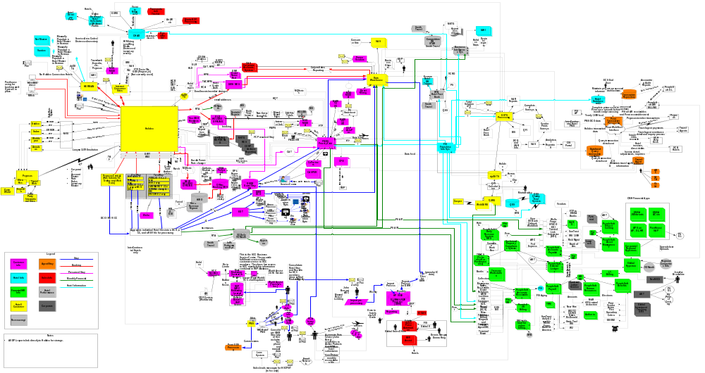
‘Spaghetti’ Architecture: Not Outsourceable
What happens if you do not outsource:
  This kind of architecture will eventually kill you;
  If your competitors outsource better, you loose;
  If your business decides to outsource over your head directly to vendors, you are gone.
B-Wave Software ®. All Rights Reserved ©

Slide 6
Optimize, Then Outsource
Legacy ‘spaghetti’ architecture makes outsourcing unfeasible because all outsourceable parts (applications) are entangled into a ‘hairball’ and inseparable;
If applications are isolated, they are easily outsourceable but are non-integrateable afterwards;
To operate efficiently, including the efficient outsourcing, Enterprise has first to improve its EA and reach some Desired State, which we call ‘Elegant Enterprise’
B-Wave Software ®.
All Rights Reserved ©

Slide 7
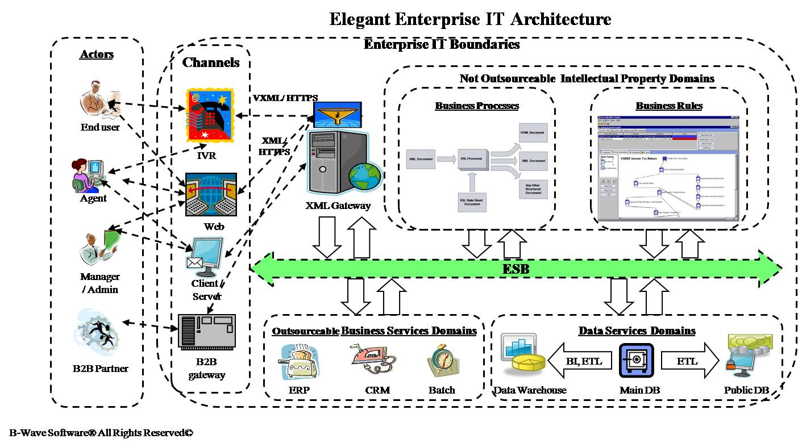
‘Elegant Enterprise’ As The Perfect Desirable Pre-Cloud EA State - What
B-Wave Software ®. All Rights Reserved ©

Slide 8

Event-Driven Elegant Enterprise
Let us explain the operational behavior of such an Enterprise considering the usual Event-Driven user request scenario:
  One of the external Actors places a service request through one of the Channels;
  This request is translated into one of the standard (usually XML-based) formats through XML /Security Gateway and is placed to the ESB as a request message;
  The corresponding Business Process Flow(BPF) Instance in a BPMS reacts by proceeding through BPF;
  On the way it calls, in an uncoupled manner, different services from Business and Data Service domains, as well as Business Rule Engine (BRE) services.
  Every service produces some functional activities and reacts with a reply message containing information that eventually reaches the actor to notify her that the request has been fulfilled (or not)
B-Wave Software ®.
All Rights Reserved ©

Slide 9
BPM As The Cornerstone of Enterprise
Enterprise runs its Business Processes(BP); it is all it ever does;
Only a BP can verify whether the Enterprise needs a particular service or data entity; if no one process uses them then Enterprise does not need them; there is no other way to identify what it needs.
So, every valid Enterprise Architecture must start from identifying Business Process Domains (BPD) and Flows (BPF)
B-Wave Software ®.
All Rights Reserved ©

Slide 10
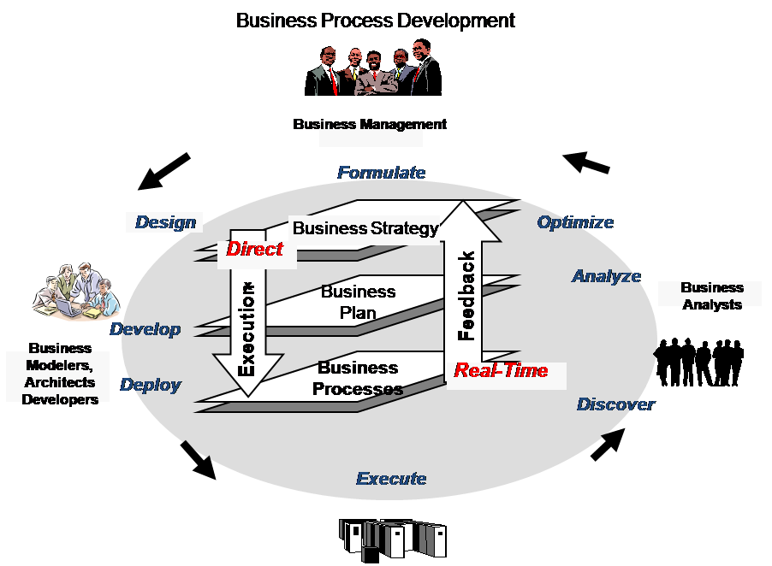
Business Process Development Life Cycle
Business/IT
Gap
IT Boundaries
B-Wave Software ®.
All Rights Reserved ©

Slide 11
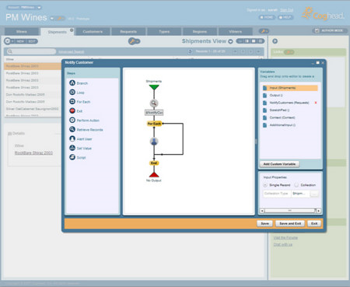
BPMS AAS (Coghead®/Intalio® Example)
Coghead®,” a BPM-in-the-cloud service that uses Intalio® as the process engine under the covers”.
The entire app is Web 2.0, accessible through Google Gadgets™ or iFrame™
“All of the data lives in Coghead®; [it] provides a ‘linked application’ feature, in which a facade on Coghead communicates with a RESTful API on your app behind the firewall, which … is based on the Atom Publishing Protocol (APP).¹”
Coghead BP Designer
¹ Greg Olson. The keynote at Intalio®
User Conference.
B-Wave Software ®.
All Rights Reserved ©

Slide 12
BPMS AAS – How it Works for Enterprise
Enterprise’s Business is interested in how BPs are defined and in the results of their execution; it is not interested in how or where they are executed, as long as this execution brings about the right business results;
If BPs are run outside of the Enterprise securely, effectively, and efficiently, this might be the preferred way for the Enterprise Business Management to do it.
If we change the word ‘app’ in the statement on the previous slide to the more appropriate word ‘service’, we have a conceptually complete picture of BPM/ESB/SOA-based Enterprise Architecture, fully immersed into Cloud, which requires only two groups of in-house Enterprise professionals:
  Advanced Business Analysts (BA) who are able to create basic Business Process Flows/Subflows (BPF) and Business Rules, working with Cloud-based tools like Coghead® BPMS and any internal or external Business Rules Engine, communicating through ESB;
  Cloud company - employed Software Designers, able to make these processes executable , design and develop corresponding services with coordination with other SAAS teams, and then run them through this outsourced BPMS and all other SAAS domains.
B-Wave Software ®.
All Rights Reserved ©

Slide 13

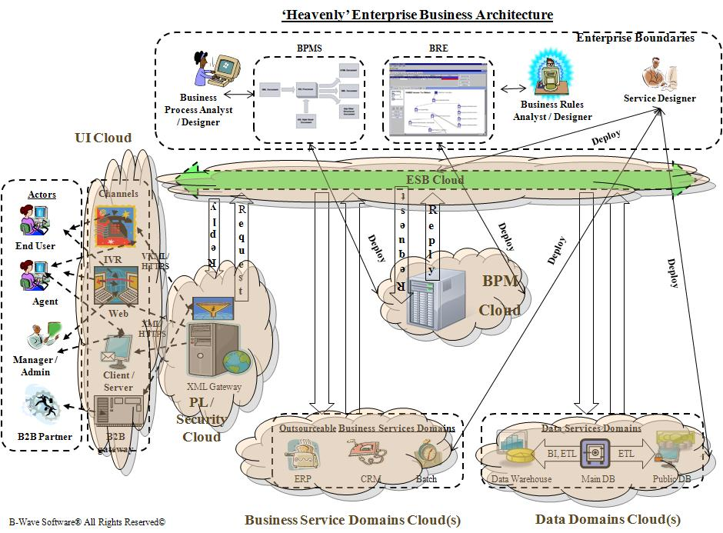
The Architectural Result Of BPMS AAS -
Cloud Oriented Architecture
Introducing ‘Heavenly Enterprise’ with IT As A Service (ITAAS)
B-Wave Software ®.
All Rights Reserved ©

Slide 14
Summary
The tendency for Enterprises to move their IT operations to Cloud is based both on the potentially higher efficiency of utility computing and on the Business’s disappointment over inability of in-house IT to meet its needs during the current, much more complex, Architectural phase of IT operations;
What Enterprise outsources into Cloud is its Enterprise Architecture (EA); obviously the benefits of such outsourcing depend on the quality of what is being outsourced;
The outsourcing on application basis will make integration of those applications into EA much more complicated and cost-consuming, significantly decreasing the efficiency of such outsourcing;
Any attempt to outsource Legacy EA with its chaotic ‘spaghetti’ inter-application relationships may only worsen the EA state of the Enterprise and lead to negative business consequences;
The only valid approach (from EA point of view ) to IT outsourcing is on service domain basis; to be able implementing it , Enterprise should first reach its pre-Cloud Desired State – BPM/ESB/SOA-based ‘Elegant Enterprise’
The only thing that an Enterprise does is running its Business Processes (BP);
BPM as the bridge between Business and IT makes it possible to turn usual Business Analysts into BP Designers, enabling them to take real responsibility for the BPs that their Enterprise runs;
The emerging of BPMS AAS enables enterprises to outsource all operations beyond BP Design into Cloud, thus advancing to the post-IT Architectural state – ‘Heavenly Enterprise’.
B-Wave Software ®.
All Rights Reserved ©

Slide 15
Thank You
Wolf Rivkin
Chief Enterprise Architect B-Wave Software LLC.
Web: http://www.b-wavesoft.com
Email: wrivkin@b-wavesoft.com
B-Wave Software ®.
All Rights Reserved ©

